Slide 1
Summary
Queries

Slide 2
A lot of query requests don’t need to return a bunch of rows.
Sometimes it needs to only return a single value or a small number of values that summarizes the contents of a database.
Summary queries in SQL allow us to do this.
Using summary queries we can ask questions like :
What is the average sales of the Chicago office
What is the highest GPA at the university ?
How many employees earn below $25000 ?
How many students are in Arts ?
What is the average size of an order ?

Slide 3
SQL lets you summarize data through column functions.
A column function takes an entire column of data and summarizes it into a single data item.
(NOTE : null values are ignored in summary functions)
For example, to find the average grade for 5 students, the grades are added and divided by the number of grades.
If one grade is null, the null value is not added to the sum (i.e. null value does not mean zero)
Therefore, sum is divided by 4 not by 5

Slide 4
Here are 6 basic column functions
SUM(): computes the total of a column
AVG(): computes the average of a column
MIN(): computes the minimum value in a column
MAX(): computes the largest value in a column
COUNT(): counts number of values in a column
COUNT(*): counts rows of query results

Slide 5
The SUM column function
The SUM() column function is used to compute the numerical sum of an entire column.
Here are some examples of the use of the SUM() column function
Question:
What are the total quotas and sales for all salespersons ?
SELECT SUM(Quota) AS “SumOfQuota”, SUM(Sales) AS “SumOfSales”
FROM Salesreps;
Note that column functions do not have proper heading. This is similar to calculated values.

Slide 6
Empl_Num Name Age Rep_Office Title Hire_Date Manager Quota Sales
105 Bill Adams 37 13 Sales Rep 12-FEB-88 104 350000 367911
109 Mary Jones 31 11 Sales Rep 12-OCT-89 106 300000 392725
102 Sue Smith 48 21 Sales Rep 10-DEC-86 108 350000 474050
106 Sam Clark 52 11 VP Sales 14-JUN-88 275000 299912
104 Bob Smith 33 12 Sales Mgr 19-MAY-87 106 200000 142594
101 Dan Roberts 45 12 Sales Rep 20-OCT-86 104 300000 305673
110 Tom Synder 41 Sales Rep 13-JAN-90 101 75985
108 Larry Fitch 62 21 Sales Mgr 12-OCT-89 106 350000 361865
103 Paul Cruz 29 12 Sales Rep 01-MAR-87 104 275000 286775
107 Nacy Angelli 49 22 Sales Rep 14-NOV-88 108 300000 186042
Result:
SumOfQuota SumOfSales
$2,700,000.00 $2,893,532.00

Slide 7
What is the total of the orders taken by Mary Jones ?
SELECT SUM(Amount) AS “TotAmtOfMaryJones”
FROM Orders, Salesreps
WHERE (Rep = Empl_Num) AND (Name = ‘Mary Jones’);
TotAmtOfMaryJones
$7,105.00

Slide 8
What is the total sales of all the offices combined ?
SELECT SUM(Sales) AS “TotalSales”
FROM Offices;
TotalSales
$2,817,547.00

Slide 9
What is the sum of all orders that exceed $5000.00 each ?
SELECT SUM(Amount) AS “TotAmtOver5000”
FROM Orders
WHERE Amount > 5000;
TotAmtOver5000
$208,075.00

Slide 10
Order_Num Order_Date Cust Rep Mfr Product Qty Amount
112961 17-DEC-89 2117 106 REI 2A44L 7 31500
113012 11-JAN-90 2111 105 ACI 41003 35 3745
112989 03-JAN-90 2101 106 FEA 114 6 1458
113051 10-FEB-90 2118 108 QSA K47 4 1420
112968 12-OCT-89 2102 101 ACI 41004 34 3978
113036 30-JAN-90 2107 110 ACI 4100Z 9 22500
113045 02-FEB-90 2112 108 REI 2A44R 10 45000
112963 17-DEC-89 2103 105 ACI 41004 28 3276
113013 14-JAN-90 2118 108 BIC 41003 1 652
113058 23-FEB-90 2108 109 FEA 112 10 1480
112997 08-JAN-90 2124 107 BIC 41003 1 652
112983 27-DEC-89 2103 105 ACI 41004 6 702
113024 20-JAN-90 2114 108 QSA XK47 20 7100
113062 24-FEB-90 2124 107 FEA 114 10 2430
112979 12-OCT-89 2114 102 ACI 4100Z 6 15000
113027 22-JAN-90 2103 105 ACI 41002 54 4104
113007 08-JAN-90 2112 108 IMM 773C 3 2925
113069 02-MAR-90 2109 107 IMM 775C 22 31350
113034 29-JAN-90 2107 110 REI 2A45C 8 632
112992 04-NOV-89 2118 108 ACI 41002 10 760
112975 12-OCT-89 2111 103 REI 2A44G 6 2100
113055 15-FEB-90 2108 101 ACI 4100X 6 150
113048 10-FEB-90 2120 102 IMM 779C 2 3750
112993 04-JAN-89 2106 102 REI 2A45C 24 1896
113065 27-FEB-90 2106 102 QSA XK47 6 2130
113003 25-JAN-90 2108 109 IMM 779C 3 5625
113049 10-FEB-90 2118 108 QSA XK47 2 776
112987 31-DEC-89 2103 105 ACI 4100Y 11 27500
113057 18-FEB-90 2111 103 ACI 4100X 24 600
113042 02-FEB-90 2113 101 REI 2A44R 5 22500

Slide 11
What is the total quota of all the Salesreps ?
SELECT SUM(Quota) AS “TotalQuota”
FROM Salesreps;
TotalQuota
$2,700,000.00

Slide 12
Calculate the average size of an order placed by Acme Mfg. (customer number 2103)
SELECT AVG(Amount) AS “AvgAmountFor2103”
FROM Orders
WHERE Cust= 2103;
AvgAmountFor2103
8895.5

Slide 13
Order_Num Order_Date Cust Rep Mfr Product Qty Amount
112961 17-DEC-89 2117 106 REI 2A44L 7 31500
113012 11-JAN-90 2111 105 ACI 41003 35 3745
112989 03-JAN-90 2101 106 FEA 114 6 1458
113051 10-FEB-90 2118 108 QSA K47 4 1420
112968 12-OCT-89 2102 101 ACI 41004 34 3978
113036 30-JAN-90 2107 110 ACI 4100Z 9 22500
113045 02-FEB-90 2112 108 REI 2A44R 10 45000
112963 17-DEC-89 2103 105 ACI 41004 28 3276
113013 14-JAN-90 2118 108 BIC 41003 1 652
113058 23-FEB-90 2108 109 FEA 112 10 1480
112997 08-JAN-90 2124 107 BIC 41003 1 652
112983 27-DEC-89 2103 105 ACI 41004 6 702
113024 20-JAN-90 2114 108 QSA XK47 20 7100
113062 24-FEB-90 2124 107 FEA 114 10 2430
112979 12-OCT-89 2114 102 ACI 4100Z 6 15000
113027 22-JAN-90 2103 105 ACI 41002 54 4104
113007 08-JAN-90 2112 108 IMM 773C 3 2925
113069 02-MAR-90 2109 107 IMM 775C 22 31350
113034 29-JAN-90 2107 110 REI 2A45C 8 632
112992 04-NOV-89 2118 108 ACI 41002 10 760
112975 12-OCT-89 2111 103 REI 2A44G 6 2100
113055 15-FEB-90 2108 101 ACI 4100X 6 150
113048 10-FEB-90 2120 102 IMM 779C 2 3750
112993 04-JAN-89 2106 102 REI 2A45C 24 1896
113065 27-FEB-90 2106 102 QSA XK47 6 2130
113003 25-JAN-90 2108 109 IMM 779C 3 5625
113049 10-FEB-90 2118 108 QSA XK47 2 776
112987 31-DEC-89 2103 105 ACI 4100Y 11 27500
113057 18-FEB-90 2111 103 ACI 4100X 24 600
113042 02-FEB-90 2113 101 REI 2A44R 5 22500

Slide 14
The MAX and MIN column functions
The MAX and MIN column functions are used to find the maximum and minimum values in an entire columns.
What are the smallest and largest assigned quotas ?
SELECT MIN(QUOTA) AS “MinQuota”, MAX(QUOTA) AS “MaxQuota”
FROM Salesreps;

Slide 15
Empl_Num Name Age Rep_Office Title Hire_Date Manager Quota Sales
105 Bill Adams 37 13 Sales Rep 12-FEB-88 104 350000 367911
109 Mary Jones 31 11 Sales Rep 12-OCT-89 106 300000 392725
102 Sue Smith 48 21 Sales Rep 10-DEC-86 108 350000 474050
106 Sam Clark 52 11 VP Sales 14-JUN-88 275000 299912
104 Bob Smith 33 12 Sales Mgr 19-MAY-87 106 200000 142594
101 Dan Roberts 45 12 Sales Rep 20-OCT-86 104 300000 305673
110 Tom Synder 41 Sales Rep 13-JAN-90 101 75985
108 Larry Fitch 62 21 Sales Mgr 12-OCT-89 106 350000 361865
103 Paul Cruz 29 12 Sales Rep 01-MAR-87 104 275000 286775
107 Nacy Angelli 49 22 Sales Rep 14-NOV-88 108 300000 186042
MinQuota MaxQuota
$200000.00 $350,000.00

Slide 16
What is the earliest order date in the database ?
SELECT MIN(Order_Date) AS “EarliestOrder”
FROM Orders;
EarliestOrder
04-JAN-89

Slide 17
The COUNT column function
This function counts the number of rows returned by a query or the number of data values in a column depending on how it is used
How many customers are there ?
SELECT COUNT(*) AS “NumOfCustomers”
FROM Customers;
This counts the number of rows returned by the query.
NumOfCustomers
21

Slide 18
Cust_Num Company Cust_Rep Credit_Limit
2111 JCP Inc. 103 50000
2102 First Corp. 101 65000
2103 Acme Mfg. 105 50000
2123 Carter and Sons 102 40000
2107 Ace International 110 35000
2115 Smithson Corp. 101 20000
2101 Jones Mfg. 106 65000
2112 Zetacorp 108 50000
2121 QMA Assoc. 103 45000
2114 Orion Corp. 102 20000
2124 Peter Brothers 107 40000
2108 Holm and Landis 109 55000
2117 J.P. Sinclair 106 35000
2122 Three-Way Lines 105 30000
2120 Rico Enterprises 102 50000
2106 Fred Lewis Corp. 102 65000
2119 Solomon Inc. 109 25000
2118 Midwest Systems 108 60000
2113 Ian and Schmidt 104 20000
2109 Chen Associates 103 25000
2105 AAA Investments 101 45000

Slide 19
How many salespeople are over their quota ?
SELECT COUNT(*) AS “SalesRepOverQuota”
FROM Salesreps
WHERE Sales > Quota;
SalesRepOverQuota
7
This also counts the number of rows returned by the query based on the given condition: Sales > Quota

Slide 20
Empl_Num Name Age Rep_Office Title Hire_Date Manager Quota Sales
105 Bill Adams 37 13 Sales Rep 12-FEB-88 104 350000 367911
109 Mary Jones 31 11 Sales Rep 12-OCT-89 106 300000 392725
102 Sue Smith 48 21 Sales Rep 10-DEC-86 108 350000 474050
106 Sam Clark 52 11 VP Sales 14-JUN-88 275000 299912
104 Bob Smith 33 12 Sales Mgr 19-MAY-87 106 200000 142594
101 Dan Roberts 45 12 Sales Rep 20-OCT-86 104 300000 305673
110 Tom Synder 41 Sales Rep 13-JAN-90 101 75985
108 Larry Fitch 62 21 Sales Mgr 12-OCT-89 106 350000 361865
103 Paul Cruz 29 12 Sales Rep 01-MAR-87 104 275000 286775
107 Nacy Angelli 49 22 Sales Rep 14-NOV-88 108 300000 186042
SalesRepOverQuota
7

Slide 21
How many orders are over $25000 ?
SELECT COUNT(*) AS “OrderOver25000”
FROM Orders
WHERE Amount > 25000;
OrderOver25000
4

Slide 22
Order_Num Order_Date Cust Rep Mfr Product Qty Amount
112961 17-DEC-89 2117 106 REI 2A44L 7 31500
113012 11-JAN-90 2111 105 ACI 41003 35 3745
112989 03-JAN-90 2101 106 FEA 114 6 1458
113051 10-FEB-90 2118 108 QSA K47 4 1420
112968 12-OCT-89 2102 101 ACI 41004 34 3978
113036 30-JAN-90 2107 110 ACI 4100Z 9 22500
113045 02-FEB-90 2112 108 REI 2A44R 10 45000
112963 17-DEC-89 2103 105 ACI 41004 28 3276
113013 14-JAN-90 2118 108 BIC 41003 1 652
113058 23-FEB-90 2108 109 FEA 112 10 1480
112997 08-JAN-90 2124 107 BIC 41003 1 652
112983 27-DEC-89 2103 105 ACI 41004 6 702
113024 20-JAN-90 2114 108 QSA XK47 20 7100
113062 24-FEB-90 2124 107 FEA 114 10 2430
112979 12-OCT-89 2114 102 ACI 4100Z 6 15000
113027 22-JAN-90 2103 105 ACI 41002 54 4104
113007 08-JAN-90 2112 108 IMM 773C 3 2925
113069 02-MAR-90 2109 107 IMM 775C 22 31350
113034 29-JAN-90 2107 110 REI 2A45C 8 632
112992 04-NOV-89 2118 108 ACI 41002 10 760
112975 12-OCT-89 2111 103 REI 2A44G 6 2100
113055 15-FEB-90 2108 101 ACI 4100X 6 150
113048 10-FEB-90 2120 102 IMM 779C 2 3750
112993 04-JAN-89 2106 102 REI 2A45C 24 1896
113065 27-FEB-90 2106 102 QSA XK47 6 2130
113003 25-JAN-90 2108 109 IMM 779C 3 5625
113049 10-FEB-90 2118 108 QSA XK47 2 776
112987 31-DEC-89 2103 105 ACI 4100Y 11 27500
113057 18-FEB-90 2111 103 ACI 4100X 24 600
113042 02-FEB-90 2113 101 REI 2A44R 5 22500

Slide 23
The keyword COUNT
In how many cities, the company have sales?
SELECT COUNT(City) AS “NumOfCities”
FROM Offices;
NumOfCities
6
This counts the number of values in column City (Not the number of rows)

Slide 24
Show the titles of the Salesreps.
SELECT Title
FROM Salesreps;
How many titles are held by Salesreps?
SELECT COUNT(Title) AS “DifferentTitles”
FROM Salesreps;
Note that the NULL values are omitted by the COUNT function when counting on a column
TITLE
Sales Rep
Sales Rep
Sales Rep
VP Sales
Sales Mgr
Sales Rep
Sales Rep
Sales Mgr
Sales Rep
Sales Rep
DifferentTitles
10

Slide 25
The DISTINCT keyword in COUNT
Sometimes a query can return rows where 2 rows are the same. To eliminate duplicate values from a column use the DISTINCT keyword inside the COUNT.
How many different titles are held by salespeople ?
SELECT COUNT(DISTINCT Title) AS “DifferentTitles”
FROM Salesreps;
DifferentTitles
3

Slide 26
Empl_Num Name Age Rep_Office Title Hire_Date Manager Quota Sales
105 Bill Adams 37 13 Sales Rep 12-FEB-88 104 350000 367911
37 Jim Anderson 12-FEB-02 0
109 Mary Jones 31 11 Sales Rep 12-OCT-89 106 300000 392725
102 Sue Smith 48 21 Sales Rep 10-DEC-86 108 350000 474050
106 Sam Clark 52 11 VP Sales 14-JUN-88 275000 299912
104 Bob Smith 33 12 Sales Mgr 19-MAY-87 106 200000 142594
101 Dan Roberts 45 12 Sales Rep 20-OCT-86 104 300000 305673
110 Tom Synder 41 Sales Rep 13-JAN-90 101 75985
108 Larry Fitch 62 21 Sales Mgr 12-OCT-89 106 350000 361865
103 Paul Cruz 29 12 Sales Rep 01-MAR-87 104 275000 286775
107 Nacy Angelli 49 22 Sales Rep 14-NOV-88 108 300000 186042

Slide 27
How many different offices have salespeople over their quotas?
SELECT COUNT(DISTINCT City) AS “CitiesOverQuota”
FROM Salesreps, Offices
WHERE (Rep_Office = Office) AND (Salesreps.Sales > Quota);
CitiesOverQuota
4

Slide 28
Empl_Num Name Age Rep_Office Title Hire_Date Manager Quota Sales
105 Bill Adams 37 13 Sales Rep 12-FEB-88 104 350000 367911
109 Mary Jones 31 11 Sales Rep 12-OCT-89 106 300000 392725
102 Sue Smith 48 21 Sales Rep 10-DEC-86 108 350000 474050
106 Sam Clark 52 11 VP Sales 14-JUN-88 275000 299912
104 Bob Smith 33 12 Sales Mgr 19-MAY-87 106 200000 142594
101 Dan Roberts 45 12 Sales Rep 20-OCT-86 104 300000 305673
110 Tom Synder 41 Sales Rep 13-JAN-90 101 75985
108 Larry Fitch 62 21 Sales Mgr 12-OCT-89 106 350000 361865
103 Paul Cruz 29 12 Sales Rep 01-MAR-87 104 275000 286775
107 Nacy Angelli 49 22 Sales Rep 14-NOV-88 108 300000 186042
Office City Region Mgr Target Sales
22 Denver Western 108 300000 186042
11 New York Eastern 106 575000 692637
12 Chicago Eastern 104 800000 735042
13 Atlanta Eastern 105 350000 367911
21 Los Angeles Western 108 725000 835915
CitiesOverQuota
4

Slide 29
The GROUP BY clause
The summary queries described so far are like the totals at the bottom of a report.
They condense all the detailed data in the report into a single summary row of data.
Sometimes, its good to summarize query results in groups.
The GROUP BY clause of the SELECT statement provides this capability.

Slide 30
Example are the easiest way to explain how the GROUP BY clause works.
If we ask
What is the average order size? We can query as:
SELECT AVG(Amount) AS “AvgAmount”
FROM Orders;
AvgAmount
$8,256.37

Slide 31
But we want
the average order size for each salesperson. We should query as:
SELECT Name, AVG(Amount) AS “AvgAmount”
FROM Orders, Salesreps
WHERE Empl_Num = Rep
GROUP BY Name;
NAME AvgAmount
Bill Adams $7,865.40
Dan Roberts $8,876.00
Larry Fitch $8,376.14
Mary Jones $3,552.50
Nancy Angelli $11,477.33
Paul Cruz $1,350.00
Sam Clark $16,479.00
Sue Smith $5,694.00
Tom Snyder $11,566.00

Slide 32
Order)Num …. Rep Mfr Product Qty Amount
112961 …. 106 REI 2A44L 7 31500
113012 ….. 105 ACI 41003 35 3745
112989 ….. 106 FEA 114 6 1458
113051 ….. 108 QSA K47 4 1420
112968 ….. 101 ACI 41004 34 3978
113036 ….. 110 ACI 4100Z 9 22500
113045 ….. 108 REI 2A44R 10 45000
112963 ….. 105 ACI 41004 28 3276
113013 ….. 108 BIC 41003 1 652
113058 ….. 109 FEA 112 10 1480
112997 ….. 107 BIC 41003 1 652
112983 ….. 105 ACI 41004 6 702
113024 ….. 108 QSA XK47 20 7100
113062 ….. 107 FEA 114 10 2430
112979 ….. 102 ACI 4100Z 6 15000
113027 ….. 105 ACI 41002 54 4104
113007 ….. 108 IMM 773C 3 2925
113069 ….. 107 IMM 775C 22 31350
113034 ….. 110 REI 2A45C 8 632
112992 ….. 108 ACI 41002 10 760
112975 ….. 103 REI 2A44G 6 2100
113055 ….. 101 ACI 4100X 6 150
113048 ….. 102 IMM 779C 2 3750
112993 ….. 102 REI 2A45C 24 1896
113065 ….. 102 QSA XK47 6 2130
113003 ….. 109 IMM 779C 3 5625
113049 ….. 108 QSA XK47 2 776
112987 ….. 105 ACI 4100Y 11 27500
113057 ….. 103 ACI 4100X 24 600
113042 ….. 101 REI 2A44R 5 22500
Empl_Num Name …………..
105 Bill Adams …….
109 Mary Jones ……..
102 Sue Smith ……..
106 Sam Clark ……..
104 Bob Smith ……..
101 Dan Roberts ……..
110 Tom Synder ……..
108 Larry Fitch ……..
103 Paul Cruz ……..
107 Nacy Angelli ……..
***
***
***

Slide 33
The first query summarize the average over all salespersons while the second query did it for each salesperson.
The key is the GROUP BY clause.
SQL divides the orders into groups of orders, with one group for each salesperson.
Within each group, all of the orders have the same value in the Name column.
For each group, SQL computes the average value of the AMOUNT column for all the rows in the group and generates a single, summary row of query results for each group.

Slide 34
How many salespeople are assigned to each office ?
SELECT City, COUNT(*) AS “AssignedOffice”
FROM Salesreps, Offices
WHERE Rep_Office = Office
GROUP BY City;
CITY AssigndOffice
Atlanta 1
Chicago 3
Denver 1
Los Angeles 2
New York 2

Slide 35
Empl_Num Name Age Rep_Office Title Hire_Date Manager Quota Sales
105 Bill Adams 37 13 Sales Rep 12-FEB-88 104 350000 367911
109 Mary Jones 31 11 Sales Rep 12-OCT-89 106 300000 392725
102 Sue Smith 48 21 Sales Rep 10-DEC-86 108 350000 474050
106 Sam Clark 52 11 VP Sales 14-JUN-88 275000 299912
104 Bob Smith 33 12 Sales Mgr 19-MAY-87 106 200000 142594
101 Dan Roberts 45 12 Sales Rep 20-OCT-86 104 300000 305673
110 Tom Synder 41 Sales Rep 13-JAN-90 101 75985
108 Larry Fitch 62 21 Sales Mgr 12-OCT-89 106 350000 361865
103 Paul Cruz 29 12 Sales Rep 01-MAR-87 104 275000 286775
107 Nacy Angelli 49 22 Sales Rep 14-NOV-88 108 300000 186042
***
***
Office City Regin MGR Target Sales
22 Denver Western 108 300000 186042
11 New York Eastern 106 575000 692637
12 Chicago Eastern 104 800000 735042
13 Atlanta Eastern 105 350000 367911
21 Los Angeles Western 108 725000 835915
***
City AssignedOffice
Atlanta 1
Chicago 3
Denver 1
Los Angeles 2
New York 2
***

Slide 36
Multiple Grouping Columns
SQL can query results based on the contents of 2 or more columns. Here is an example.
Calculate the total orders for each customer of each salesperson
SELECT Rep, Cust, SUM(Amount) AS “SumOfAmt”
FROM Orders
GROUP BY Rep, Cust;
This will produce a single row for each rep/cust pair. SQL provides only 1 level of grouping. The query produces a separate summary row for each salesperson/customer pair.

Slide 37
Rep Cust SumOfAmt
101 2102 3978
101 2108 150
101 2113 22500
102 2106 4026
102 2114 15000
102 2120 3750
103 2111 2700
105 2103 35582
105 2111 3745
106 2101 1458
106 2117 31500
107 2109 31350
107 2124 3082
108 2112 47925
108 2114 7100
108 2118 3608
109 2108 7105
110 2107 23132
ORDER_NUM ORDER_DATE Cust Rep Mfr Product Qty AMOUNT
112961 17-DEC-89 2117 106 REI 2A44L 7 31500
113012 11-JAN-90 2111 105 ACI 41003 35 3745
112989 03-JAN-90 2101 106 FEA 114 6 1458
113051 10-FEB-90 2118 108 QSA K47 4 1420
112968 12-OCT-89 2102 101 ACI 41004 34 3978
113036 30-JAN-90 2107 110 ACI 4100Z 9 22500
113045 02-FEB-90 2112 108 REI 2A44R 10 45000
112963 17-DEC-89 2103 105 ACI 41004 28 3276
113013 14-JAN-90 2118 108 BIC 41003 1 652
113058 23-FEB-90 2108 109 FEA 112 10 1480
112997 08-JAN-90 2124 107 BIC 41003 1 652
112983 27-DEC-89 2103 105 ACI 41004 6 702
113024 20-JAN-90 2114 108 QSA XK47 20 7100
113062 24-FEB-90 2124 107 FEA 114 10 2430
112979 12-OCT-89 2114 102 ACI 4100Z 6 15000
113027 22-JAN-90 2103 105 ACI 41002 54 4104
113007 08-JAN-90 2112 108 IMM 773C 3 2925
113069 02-MAR-90 2109 107 IMM 775C 22 31350
113034 29-JAN-90 2107 110 REI 2A45C 8 632
112992 04-NOV-89 2118 108 ACI 41002 10 760
112975 12-OCT-89 2111 103 REI 2A44G 6 2100
113055 15-FEB-90 2108 101 ACI 4100X 6 150
113048 10-FEB-90 2120 102 IMM 779C 2 3750
112993 04-JAN-89 2106 102 REI 2A45C 24 1896
113065 27-FEB-90 2106 102 QSA XK47 6 2130
113003 25-JAN-90 2108 109 IMM 779C 3 5625
113049 10-FEB-90 2118 108 QSA XK47 2 776
….
***
***
***

Slide 38
Calculate the total orders for each customer of each salesperson, sorted by customer, and with each customer by salesperson.
SELECT Cust, Rep,
SUM(Amount) AS “SumOfAmt”
FROM Orders
GROUP BY Cust, Rep
ORDER BY Cust, Rep ASC;
Cust Rep SumOfAmt
2101 106 1458
2102 101 3978
2103 105 35582
2106 102 4026
2107 110 23132
2108 101 150
2108 109 7105
2109 107 31350
2111 103 2700
2111 105 3745
2112 108 47925
2113 101 22500
2114 102 15000
2114 108 7100
2117 106 31500
2118 108 3608
2120 102 3750
2124 107 3082

Slide 39
Restriction on Grouped Queries
The grouping columns must be columns of the tables we are querying from
All items appearing in the SELECT list must have a single value for each grouping.
The following is illegal
SELECT Empl_Num, Name, SUM(Amount) AS “SumOfAmt”
FROM Orders, Salesreps
WHERE Rep = Empl_Num
GROUP BY Empl_Num
This is because NAME must be specified within the grouping list also. The fix is :
SELECT Empl_Num, Name, SUM(Amount) AS “SumOfAmt”
FROM Orders, Salesreps
WHERE Rep = Empl_Num
GROUP BY Empl_Num, Name;

Slide 40
HAVING Clause
HAVING clause allows you to apply conditions to groups of a group query
What is the average order size for each salesperson whose orders total is more than $30000
SELECT Rep, AVG(Amount) AS “AvgAmt”
FROM Orders
GROUP BY Rep
HAVING SUM(Amount) > 30000.00;
Rep AvgAmt
105 $7865.40
106 $16479.00
107 $11477.33
108 $8376.14

Slide 41
HAVING vs. WHERE Clause
HAVING clause allows you to apply conditions to groups of a group query
But the WHERE clause applies to every row in the table
What is the total amount of all products sold by all manufacturers except ACI and IMM. Only list if the total sold is > 4000.
SELECT Mfr, SUM(Amount) AS “Total”
FROM Orders
WHERE Mfr NOT IN (‘ACI’, ‘IMM’)
GROUP BY Mfr
HAVING SUM(Amount) > 4000;
Mfr Total
FEA $5368
QSA $11426
REI $103628

Slide 42
For each office (print City) with 2 or more people, compute the total quota and total sales for all salespeople who work in the office.
SELECT City, SUM(Quota) AS “SumOfQuota”, SUM(Salesreps.SALES) AS“SumOfSales”
FROM Offices, Salesreps
WHERE Office = Rep_Office
GROUP BY City
HAVING COUNT(*) >= 2;
CITY SumOfQuota SumOfSales
Chicago 775000 735042
Los Angeles 700000 835915
New York 575000 692637

Slide 43
Empl_Num Name Age Rep_Office Title Hire_Date Manager Quota Sales
105 Bill Adams 37 13 Sales Rep 12-FEB-88 104 350000 367911
109 Mary Jones 31 11 Sales Rep 12-OCT-89 106 300000 392725
102 Sue Smith 48 21 Sales Rep 10-DEC-86 108 350000 474050
106 Sam Clark 52 11 VP Sales 14-JUN-88 275000 299912
104 Bob Smith 33 12 Sales Mgr 19-MAY-87 106 200000 142594
101 Dan Roberts 45 12 Sales Rep 20-OCT-86 104 300000 305673
110 Tom Synder 41 Sales Rep 13-JAN-90 101 75985
108 Larry Fitch 62 21 Sales Mgr 12-OCT-89 106 350000 361865
103 Paul Cruz 29 12 Sales Rep 01-MAR-87 104 275000 286775
107 Nacy Angelli 49 22 Sales Rep 14-NOV-88 108 300000 186042
Office City Regin MGR Target Sales
22 Denver Western 108 300000 186042
11 New York Eastern 106 575000 692637
12 Chicago Eastern 104 800000 735042
13 Atlanta Eastern 105 350000 367911
21 Los Angeles Western 108 725000 835915
City SumOfQuota SumOfSales
Chicago 775000 735042
Los Angeles 700000 835915
New York 575000 692637

Slide 44
Get the total Sales made all Salesreps of the managers
SELECT Manager, SUM(Sales) AS “Total”
FROM Salesreps
GROUP BY Manager
Manager Total
101 75985
104 960449
106 897184
108 660092
299912
In GROUP BY clause, NULL in also taken into account and all NULL values are grouped together into one group.

Slide 45
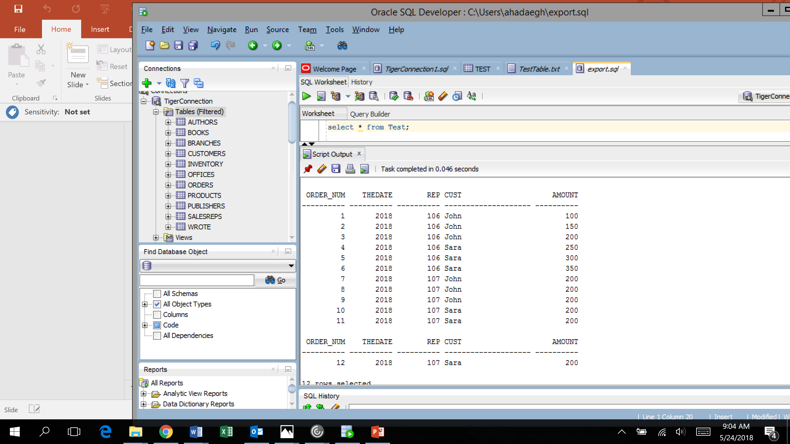
Select * from Test

Slide 46
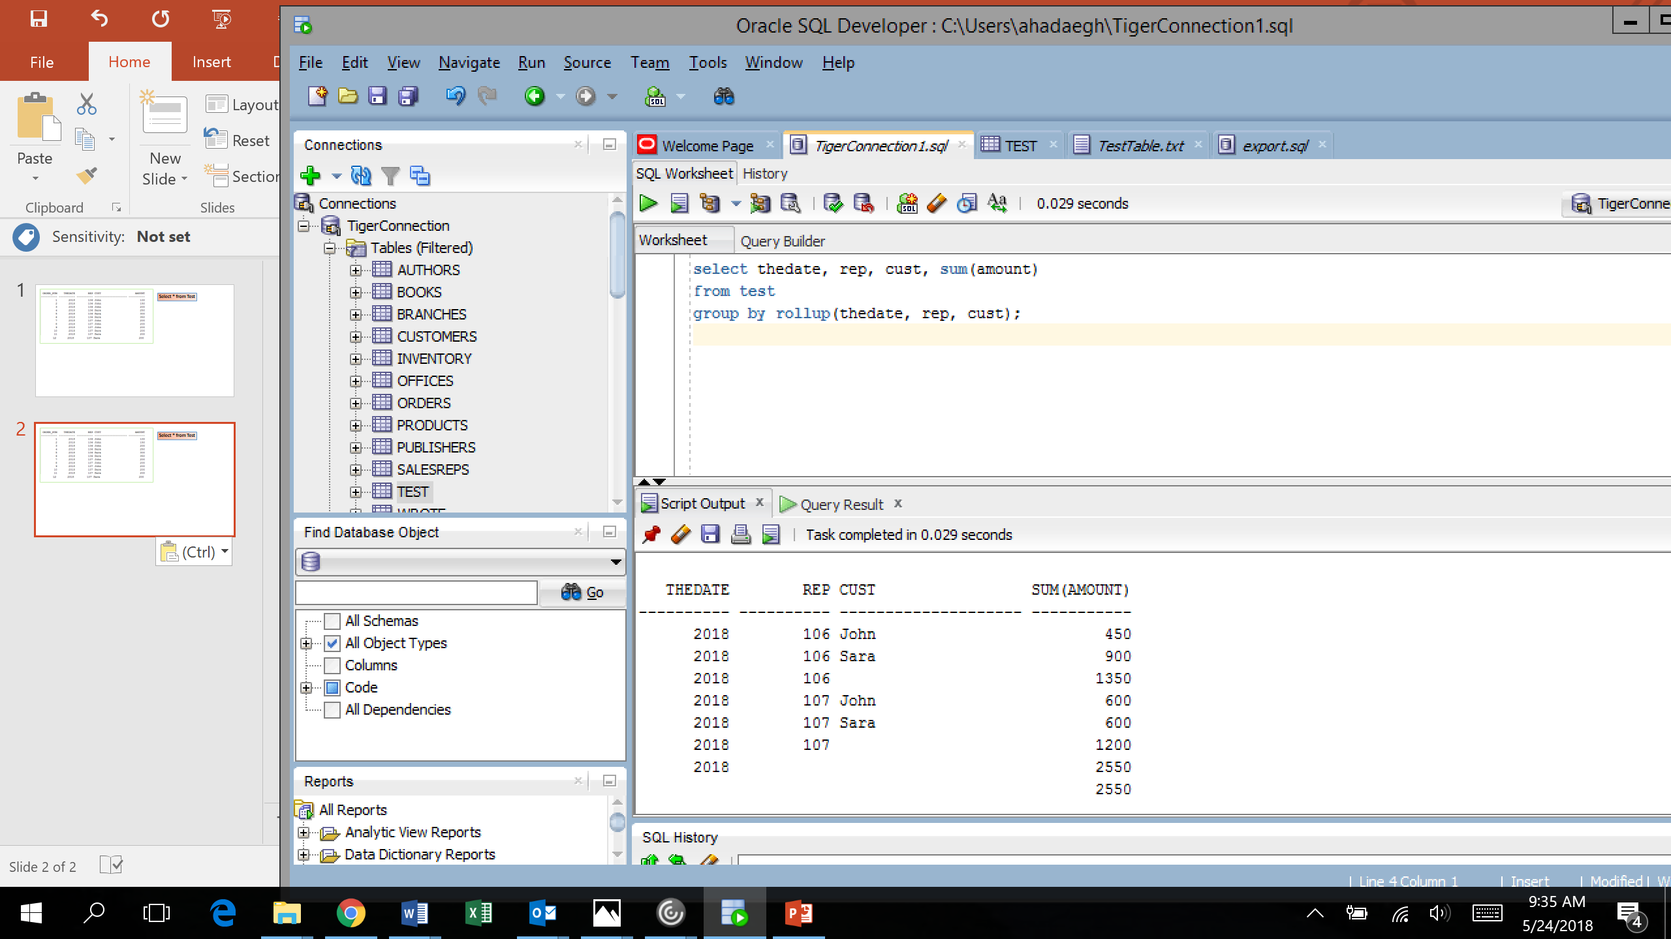
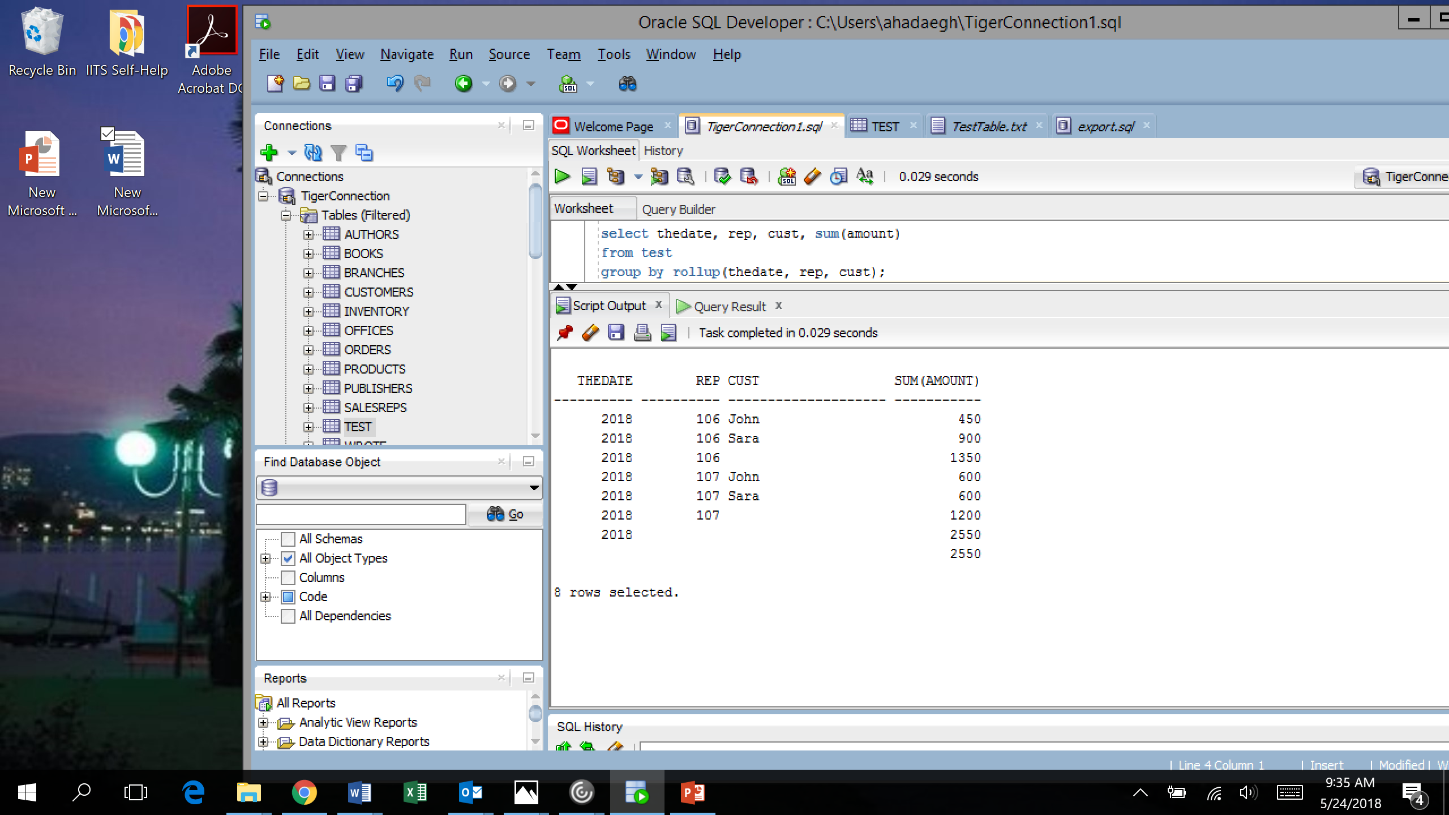

Slide 47
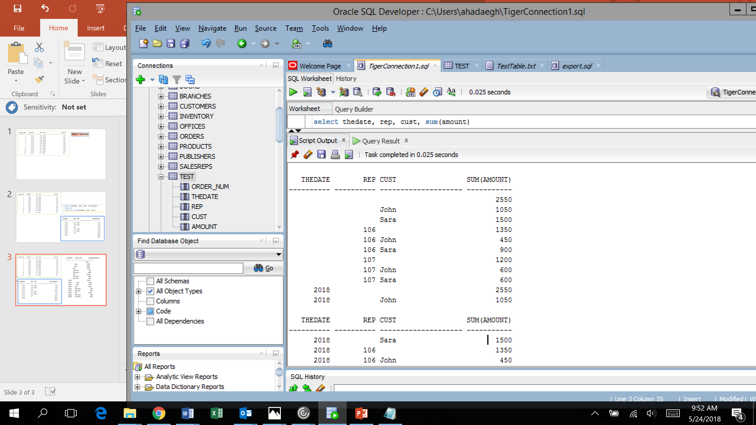
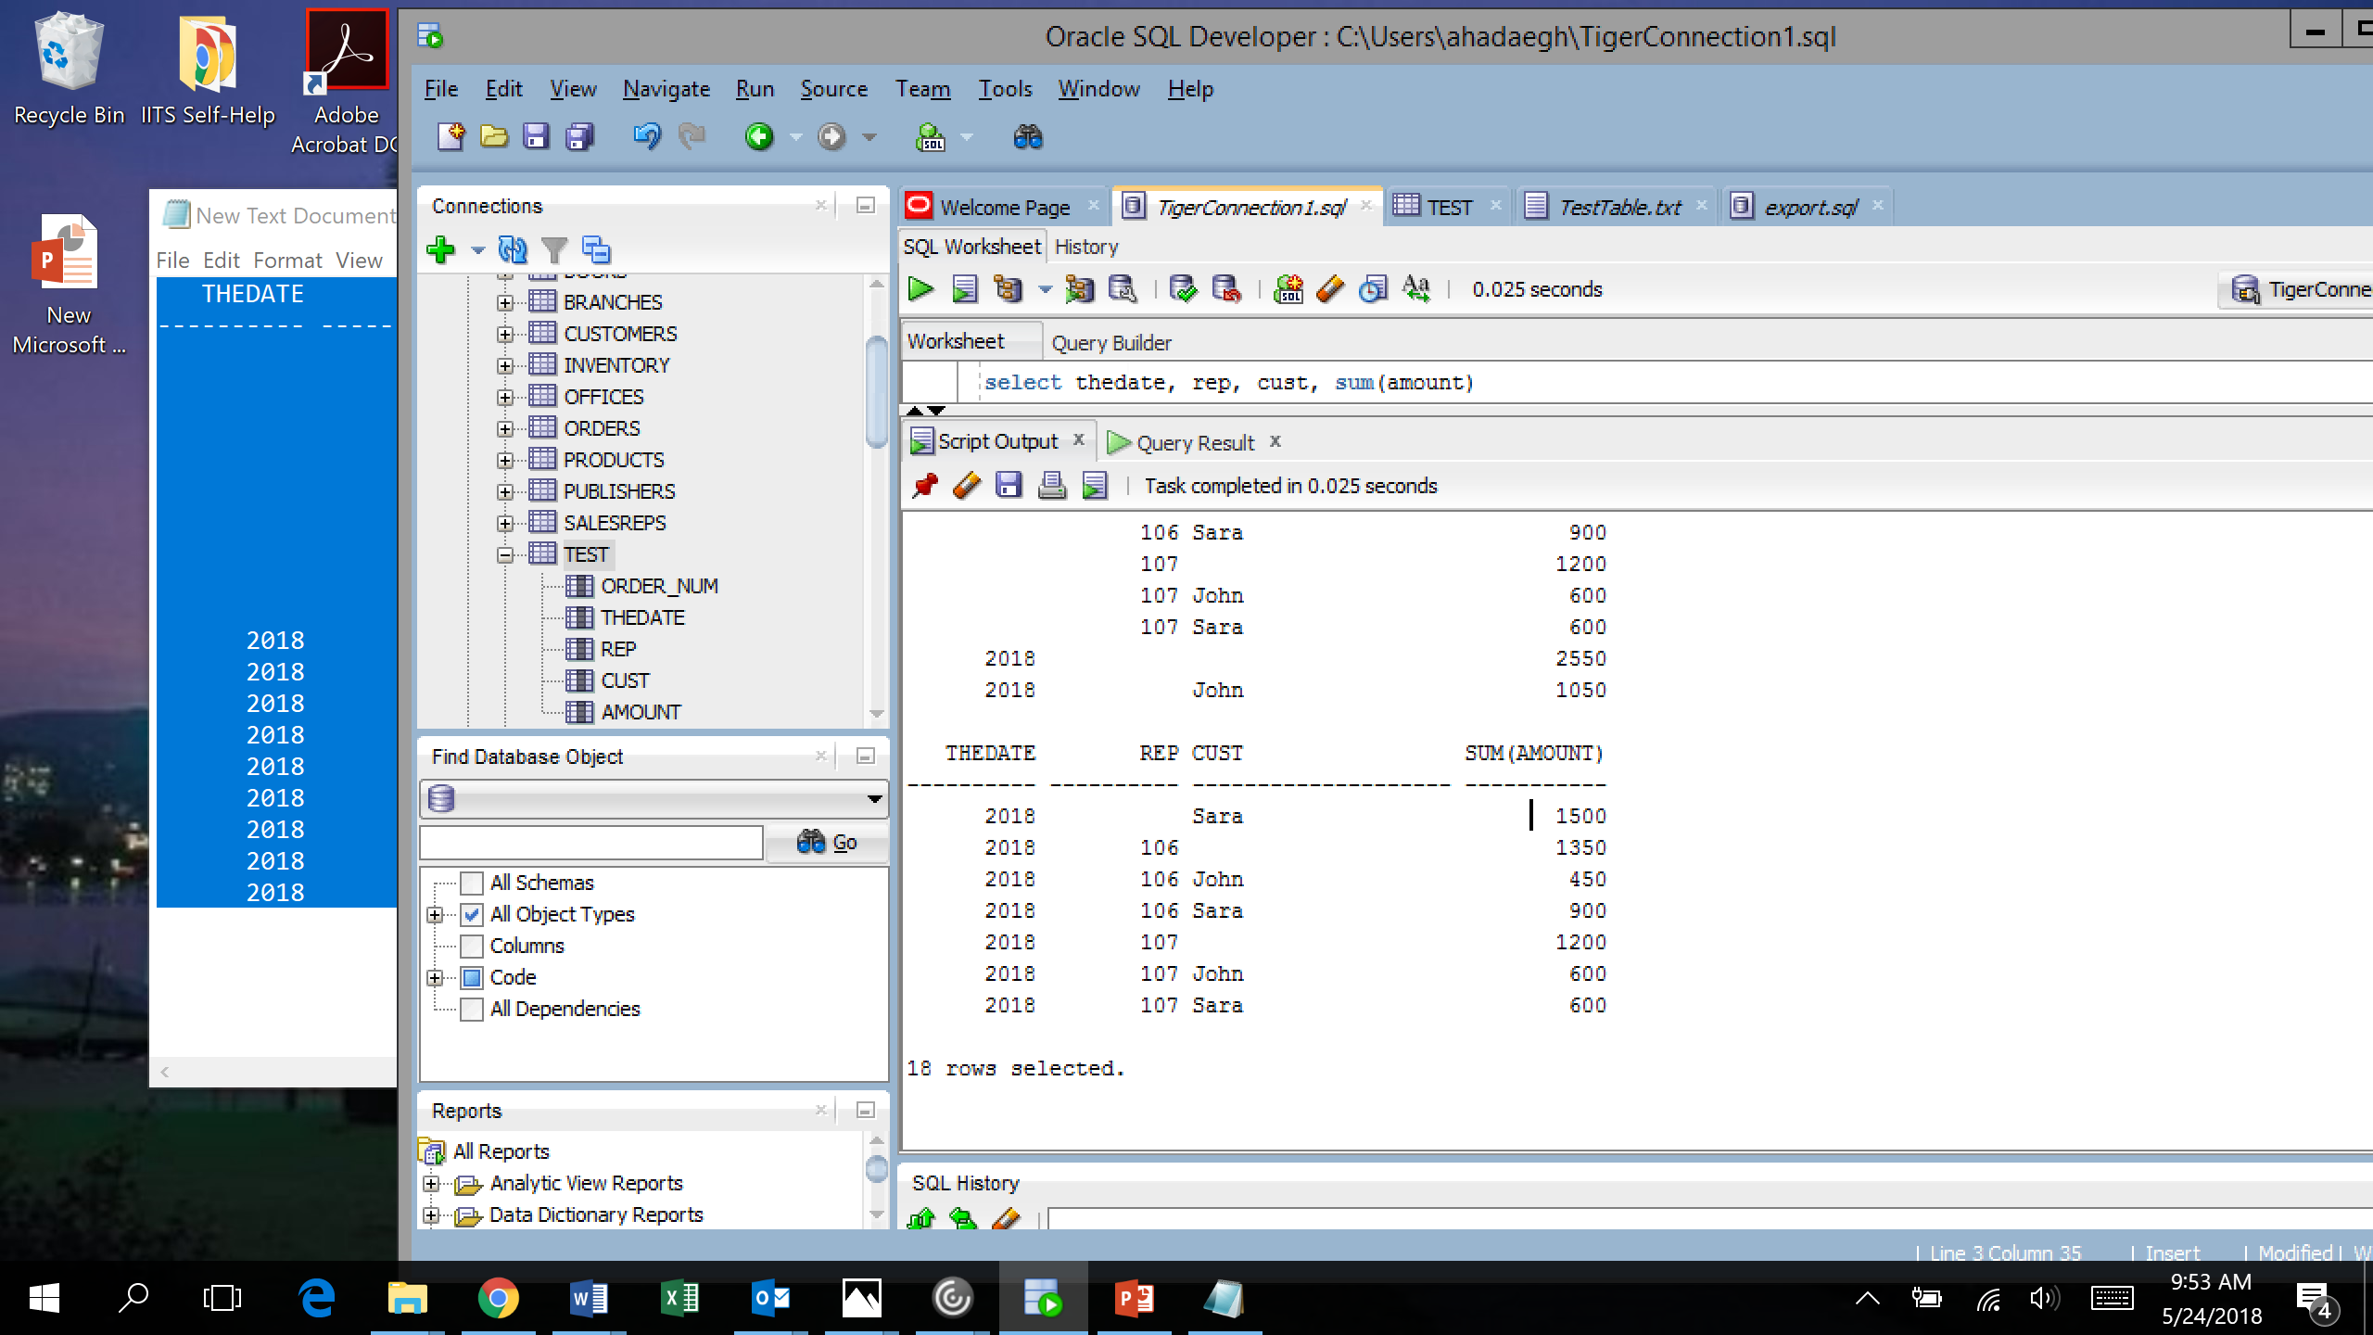
Select * from Test
select thedate, rep, cust, sum(amount)
from test group by cube(theDate, rep, cust);
select thedate, rep, cust, sum(amount)
from test group by rollup(theDate, rep, cust);

Slide 48
Select * from Test
select thedate, rep, cust, sum(amount) from test group by rollup(theDate, rep, cust);
1. TheYear
For 2018 sum is = 2550
2. TheYear, rep
For 2018 and the rep 106, the sum = 1350
For 2018 and the rep 107, the sum = 1200
3. TheYear, rep, Cost
For 2018, rep 106, customer ‘John ’, the sum is: 450
For 2018, rep 106, customer ‘Sara’, the sum is: 900
For 2018, rep 107, customer ‘John ’, the sum is: 600
For 2018, rep 107, customer ‘Sara ’, the sum is: 600
4. Total: ()
Sum is 2550
Rollup works for 4 combinations:
(TheDate),
(TheDate, Rep),
(TheDate, Rep, Cust), and
( () which is the total)

Slide 49
Cube works for all combinations:
( (TheDate), (Rep), (Cust), (TheDate, Rep),
(TheDate, Cust), (Rep, Cust),
(TheDate, Rep, Cust), ( ) )
Therefore, we will have summary for the following cases
Sum of the amount for 2008,
Sum of the amount for Rep 106
Sum of the amount for Rep 107
Sum of the amount for Cust John
Sum of the amount for Cust Sara
Sum of the amount for year 2008 and Rep 106
Sum of the amount for year 2008 and Rep 107
Sum of the amount for year 2008 and Cust John
Sum of the amount for year 2008 and Cust Sara
Sum of the amount for Rep 106 and Cust John
Sum of the amount for Rep 106 and Cust Sara
Sum of the amount for Rep 107 and Cust John
Sum of the amount for Rep 107 and Cust Sara
Sum of the amount for year 2008, 106, Cust John
Sum of the amount for year 2008, 106, cust sara
Sum of the amount for year 2008, 107, cust John
Sum of the amount for year 2008, year 107, Sara
Sum of the amount
select thedate, rep, cust, sum(amount)
from test group by cube(theDate, rep, cust);

Slide 50
Other Combinations:
Suppose you have three Columns called Year, Month, and Week. Then the following holds:
Year, Rollup(month, week) is: ( (year, month, week), (year, month), (year))
Year, Month, Rollup(week) is: ( (year, month, week), (year, month))
Year, Cube (Month, week) is: ((year, month, week), (year, month), (year, week), (year) )
Year, Month, Cube (week) is: ( (year, month, week), (year, month))
Composite Columns:
Rollup((year, month), week) is: (year, month, week), (year, month), () )
Rollup (year), (month, week) is: ( (year, month, week), (month, week))
Cube (( year, month), week) is: (year, month, week), (year, month), (week), ())
Cube (year), (month, week) is: (year, month, week), (month, week)
We can also define our own grouping set such as:
Select ….
……
Group by grouping set ( (year, month), (year, week), (week), …….)

Slide 51
The order of clauses in a query is
SELECT
FROM
WHERE
GROUP BY
HAVING
ORDER BY
The order of execution is
FROM
WHERE
GROUP BY
HAVING
SELECT
ORDER BY
You do not have to worry about this order. This is the order done by the DBMS while executing your query

